Slide 1
30/10/-3/11/17 6th week

Slide 2
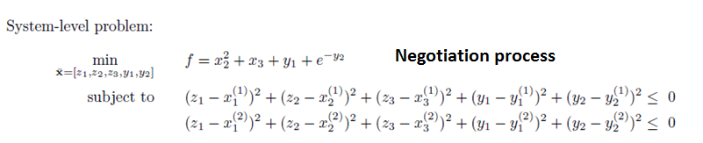
System optimization problem should be improved
Input:
Output:
Object function:
Design variables: (free to set)
No state variables

Slide 4
Global optimum = 12.5989
globalbest_Position
2.2412
0.6049
4.2328
8.0001
9.3024
Optimum = 7.9585
globalbest_Position
3.0248
0.0165
-0.0225
7.9779
5.8330

Slide 5
Conclusions
The constraint sets in the system level make sense, is better than just .
Unequal to zero increases the numbers of iteration for the optimization process, in other words, the flexible search area leads to low search efficiency.

Slide 6
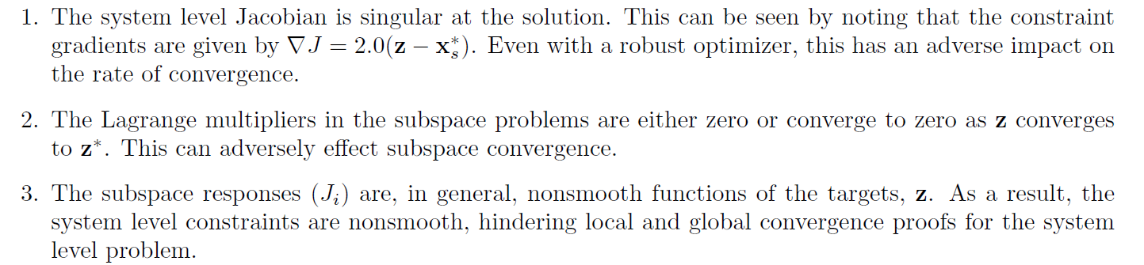
Disadvantages of original CO
The system still needs all information from its subspaces to calculate the next target values at each iteration (synchronous). Although it is improved by collecting the outputs of subspaces and make an independent optimization problem instead of those at once methods which need to have a system analysis for all disciplines.
If the connection between any subspace and the system is lost, CO fails to obtain the final optimum.

Slide 7
Enhanced Collaborative Optimization
Roth, B., & Kroo, I. (2008, September). Enhanced collaborative optimization. In 12th AIAA/ISSMO Multidisciplinary Analysis and Optimization Conference, Victoria, BC.
The key idea in this approach is to include models of the global objective and all of the subspace constraints in each subspace optimization problem while maintaining the low dimensionality of the system level problem.
Each subspace needs to make a line model of the other subspace’s constraints which needs a global knowledge at the beginning of optimization. The need of global knowledge of all participants seems impossible.
To achieve compatibility between subspaces (obtain the average of the target responses returned from the subspaces)
System
Sub 1
Sub 2
Do the most of design decisions, each subspace needs to know the disciplines of all other subspaces.
No communication but a priori knowledge

Slide 8
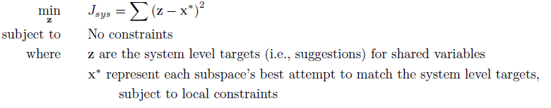
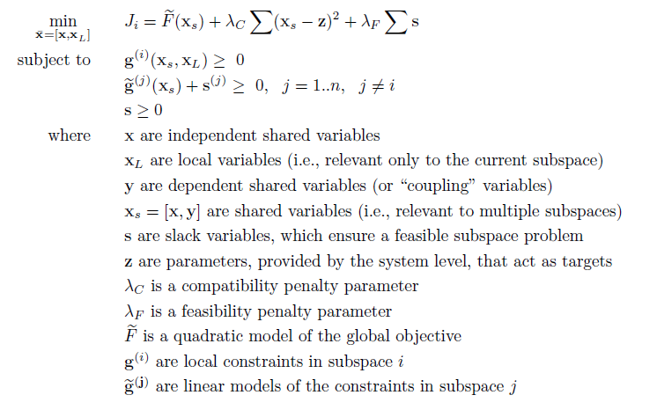
It is easy for the system but hard for the subspace.

